Slide 1
21st CCLC Fiscal Reporting Instructions
May 8, 2025
Jenell Walters – Management Technician
Notes:
Introduction

Slide 2
Pennsylvania Department of Education
Fiscal Team
Jenell Walters, Management Technician
jenewalter@pa.gov 717-783-2358
Maribel Martinez, Fiscal Management Specialist
marmartine@pa.gov 717-772-2429
Notes:
First point of contact – Jenell
Secondary/back up contact – Maribel

Slide 3
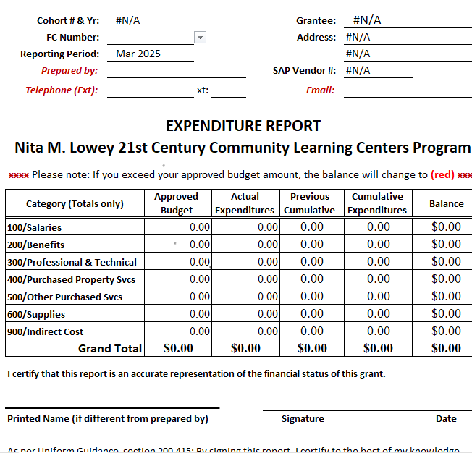

Expenditure Report-Signature Line
Notes:
This is an example of a single-page expenditure report. Your program cannot receive reimbursements without it.
Expenditure reports must be emailed to the RA account monthly, there is no need to “CC” or email the fiscal person a second copy unless previously instructed.
Please remember to sign the report; otherwise, it will be rejected. The person who prepared the report should sign it.

Slide 4
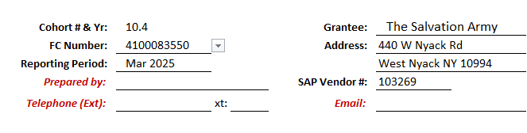
Expenditure Reports (Heading)
Notes:
The top left is your cohort year, FC or account number, the reporting period, the name of the person that prepared the report and their contact information.
When the FC number is entered, the remaining grantee information will automatically populate.
Preparer’s information will still need to be entered manually.

Slide 5
Expenditure Report- exceeding the approved budget
Notes:
If there are “red” balances on the expenditure report, you have exceeded your budget. You must contact your program officer. You need a budget revision. Do not submit your expenditure report with red balances; it will be rejected.

Slide 6
Expenditure Reports-Approved Budget
Notes:
The first column cites your program’s APPROVED BUDGET. Prior to changing these numbers, an award letter must be received. If these numbers do not match the approved budget at the Pennsylvania Department of Education (PDE), your expenditure report will be rejected. Even if the revision is made and sent to the Comptroller’s office in July and the unpaid report is from December, the expenditure report must match what is on file with the Comptroller’s office for the most recent approved budget for that cohort and year.
Your approved budget will always be whole numbers.
I check each of these reports against what is on file with the Comptroller’s office. I can’t accept approval letters provided by grantees as the Comptroller’s office will only accept the approved budget that they have on file.

Slide 7
Expenditure Reports-Actual Expenditure
Notes:
ACTUAL EXPENDITURES list the totals from the breakdown sheets.

Slide 8
Expenditure Reports-Previous Cumulative
Notes:
PREVIOUS CUMULATIVE references your program’s totals from ALL the previous months of the current grant year.
These 3 columns are the only cells that are entered in manually.

Slide 9
Expenditure Reports-Cumulative Expenditure
Notes:
CUMULATIVE EXPENDITURES populate automatically from the figures in the APPROVED BUDGET, ACTUAL EXPENDITURES, and PREVIOUS CUMULATIVE.
Grantees WILL NOT change the formulas in this column.

Slide 10
Expenditure Reports-Balance
Notes:
BALANCE populates automatically from the figures in the APPROVED BUDGET and CUMULATIVE EXPENDITURES. Grantees must be aware of the totals in this column, as the figure MUST NOT become negative. Negative figures in this column will result in an email from me reminding of the fact that expenditure reports with negative figures cannot be paid and can cause delays in payment.
Grantees WILL NOT change the formulas in this column.

Slide 11
Expenditure Reports-Certification Statement
Notes:
Directly below the budget table is the signature block. Expenditure reports that are not signed and dated will be rejected.

Slide 12
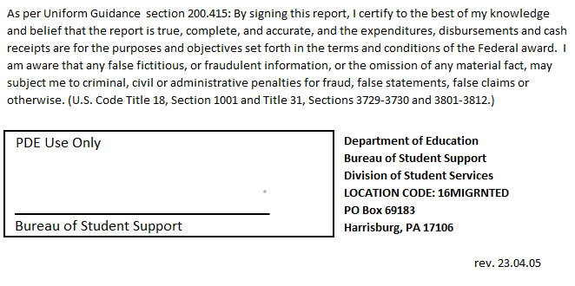
Expenditure Reports- Accuracy of Report
Notes:
The final section of the expenditure report is a certification and a PDE use signatory block.
It is preferred that all reports are uploaded.

Slide 13
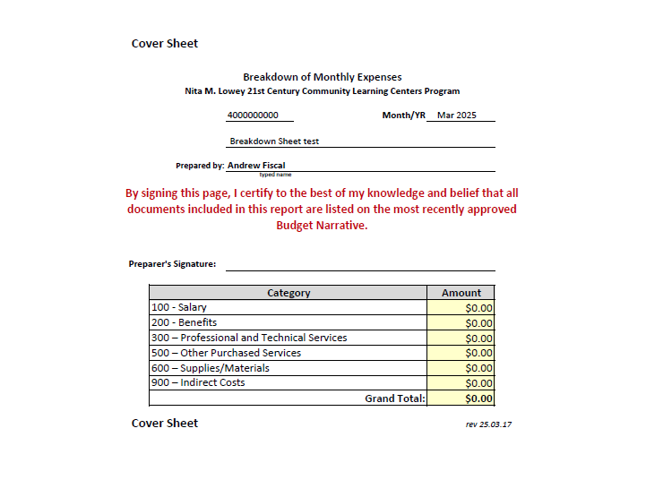
Breakdown of Monthly Expenses-Cover Sheet
Notes:
The first sheet is the COVER SHEET. The figures listed in the AMOUNT column are the totals that are listed in the ACTUAL EXPENDITURES column on the EXPENDITURE REPORT. This is the sheet that will be sent in regardless of the reimbursement amount that your program is requesting.
This sheet is formatted so that all data that you change at the top will automatically populate on the other sheets.
When using the excel templates, please take note of the following:
The layout should be portrait, not landscape.
Do not change the cell sizes; it is recommended that you hide unused cells.
Files must be uploaded as one single document. Please do not submit multiple PDFs to the FTP system.

Slide 14
Monthly Reports-Breakdown of Monthly Expenses (heading)
Notes:
All BREAKDOWN SHEETS will have the items above on them. Only those breakdown sheets that have totals for the month are necessary to turn in; HOWEVER, grantees will submit a COVER SHEET each month regardless of the amount being requested.

Slide 15
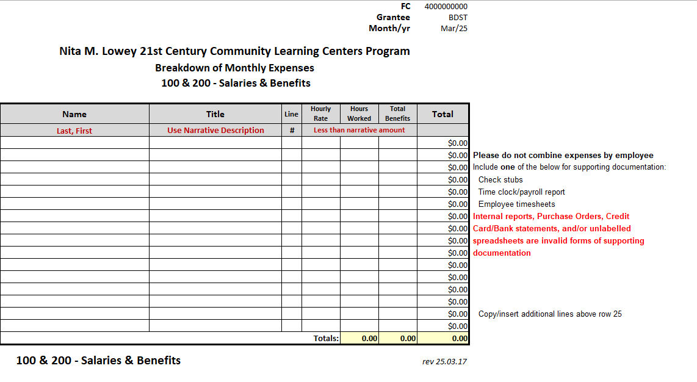
Breakdown Sheet 100 & 200
Notes:
The category 100 sheet lists ALL individuals that receive a salary or hourly wage from your program.
Individuals on this sheet are full time, part time, or temporary employees of your program. Each employee must have a name, title, rate, and hours worked. This is compared against all category 100 entries on your program’s budget narrative and the supporting documents.
Acceptable supporting documents for this category would be one of the following:
Check stub
Time clock print out
Time sheets
Unless you are using the same supporting documents for categories 100 and 200, you will add the supporting documents after this breakdown sheet

Slide 16
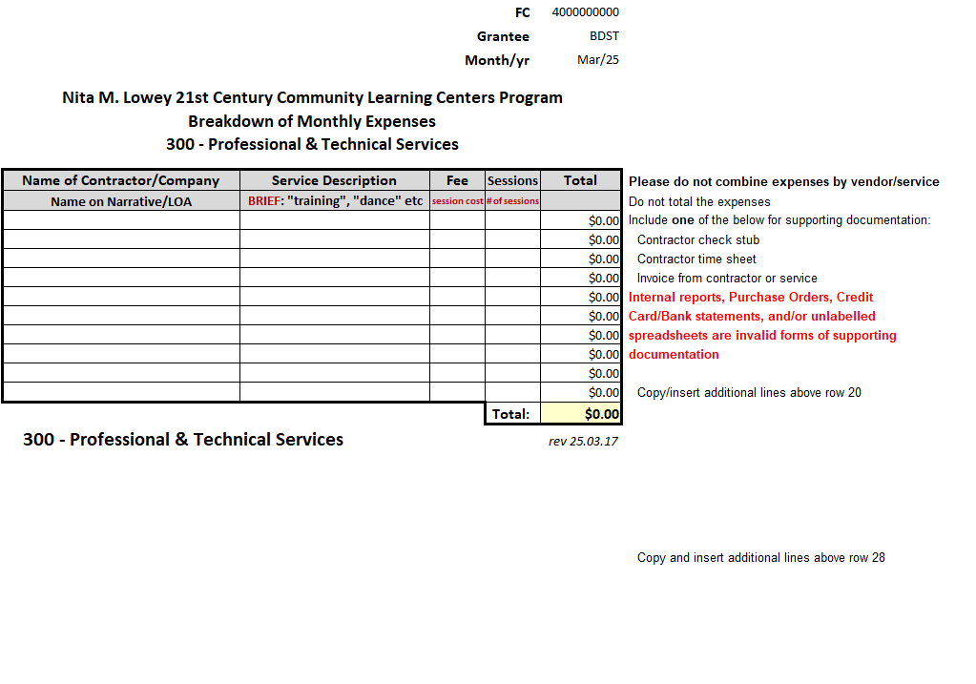
Breakdown Sheet 300
Notes:
PROFESSIONAL SERVICES/CONTRACTORS (300) There are 3 breakdown sheets for this category. The use depends on the services and/or individual classification.
Regardless of which sheet is used, it must have an entry in the NAME or CONTRACTOR, TITLE or SERVICE DESCRIPTION, HOURLY RATE or FEE, and HOURS or SESSIONS. The TOTAL AMOUNT column will calculate the amount; DO NOT CHANGE THE FORMULA. Items on these sheets can include contracted employees, payments to a temporary service, specialized services, or external evaluators. All supporting documentation should correspond to line items on the approved budget narrative.
Contracted Teachers: 21st CCLC is aware that some grantees classify their instructors as contractors. If you do not pay a third party for use of the teachers’ time, you will treat this breakdown sheet the same as the category 100 form.

Slide 17
Breakdown Sheet 400
Notes:
PURCHASED PROPERTY SERVICES (400) must have an entry in the CONTRACTOR and SERVICE DESCRIPTION. The TOTAL AMOUNT column will calculate the amount; DO NOT CHANGE THE FORMULA. Items on this sheet can include Rent, Utilities, or Snow Removal. There is no need to put in an address, as it is entered in the narrative and should be listed in any supporting documents sent. Note that this is for subgrantees that are renting a building to provide direct services to 21st CCLC students.
All supporting documentation should correspond to a line item on the narrative. If you are sending in multiple supporting documents, you will place one invoice per line – please do not combine invoice totals.

Slide 18
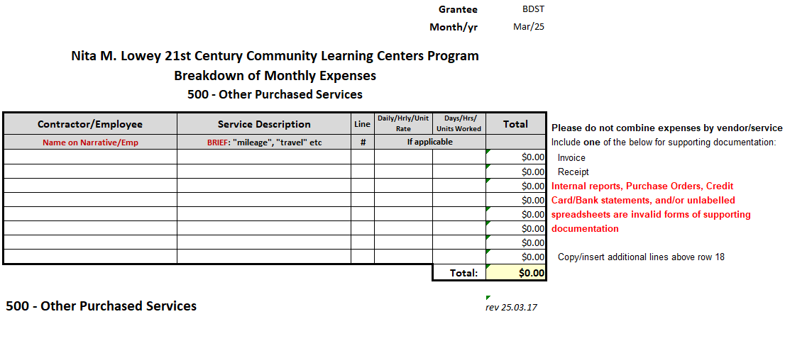
Breakdown Sheet 500
Notes:
OTHER PURCHASED SERVICES (500) must have an entry in the CONTRACTOR, SERVICE DESCRIPTION, RATE and UNITS WORKED. The TOTAL AMOUNT column will calculate the amount; DO NOT CHANGE THE FORMULA.
Items on this sheet are any and all travel expenses relating to conferences, communication costs such as cell service, land-lines, fax, cable, or internet, busses for regular or field trips, printing, or property insurance.
Units would be units of time or distance if they are applicable.

Slide 19
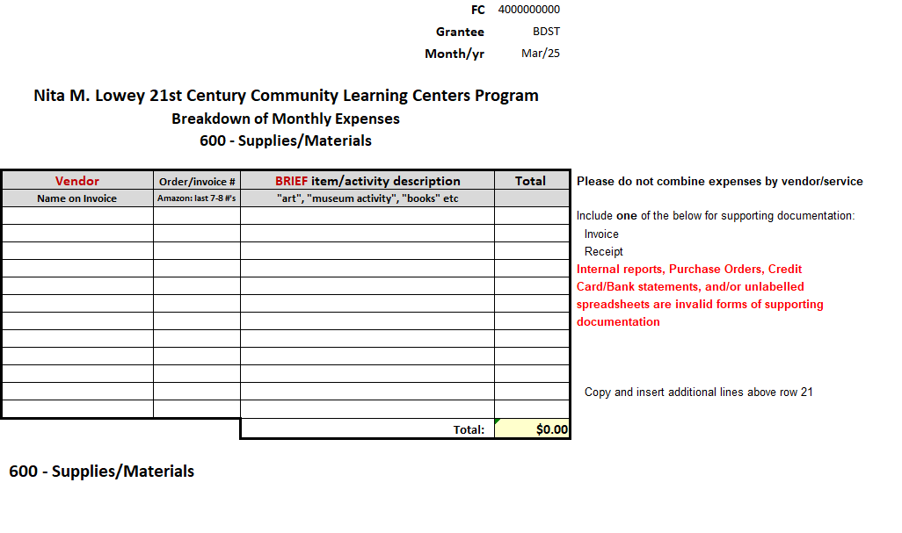
Breakdown Sheet 600
Notes:
SUPPLIES (600) must have an entry in the VENDOR, the date on the receipt or the last 7 of the invoice number from Amazon, and a brief DESCRIPTION. The TOTAL AMOUNT column will calculate the amount; DO NOT CHANGE THE FORMULA.
Items on this sheet are any and all items that are purchased for the program that are under $1000 per single unit, including but not limited to books, postage, software licenses, office, school, or cleaning supplies, or student incentives under $25 per student. If you use general categories such as art or office supplies, please indicate on the breakdown sheet which category the item is listed under in the budget narrative. For example, if you request reimbursement for popsicle sticks for an art project, you would write art supplies in the brief description.
You will fill out a line for each invoice or receipt that is sent in for supporting documentation. The description should be short and state the purpose of the item purchased. Ensure that all items requested for reimbursement are included in the budget narrative. If an item falls in a specific category, please indicate that on the breakdown sheet description.

Slide 20
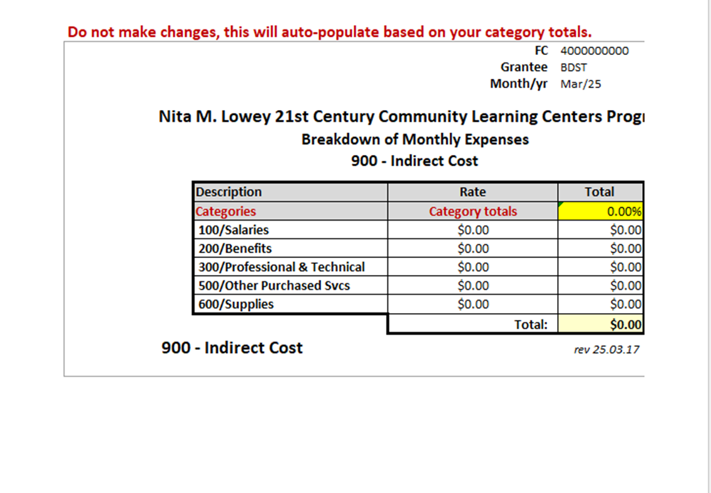
Breakdown Sheet 900
Notes:
Breakdown Sheet (900) is for indirect costs.
Indirect costs represent the operating expenses that are not readily identified with a particular subgrant, contract, project function, or activity. Still, they are necessary for the general operation of an organization and the conduct of activities it performs. In theory, expenses like heat, electricity, accounting, and personnel might be charged directly if meters could record minutes in a cross-cutting manner; however, practical difficulties preclude such an approach. Therefore, cost allocation plans, or indirect cost rates, are used to distribute those costs to benefiting revenue sources.
Rates are approved by PDE.

Slide 21

Fiscal Guidelines
All reports are due on or before the 10th of each month; failure to submit on time may increase your risk assessment score.
Prepare reports in Excel and save them as a .pdf file.
Only send one support document per claimed item or service

Slide 22
Fiscal Guidelines cont.
Expenditure Reports are to be emailed to RA-OB69183@pa.gov . This should be a single-page.
Email/upload your monthly report to the FTP site. https://copaftp.state.pa.us
Hide your empty or “$0” lines to maintain the clarity. Do not send blank breakdown sheets.
Use the proper naming conventions to ensure ease of review.
Grantee Name-Cohort #-Last 5 of FC #
When in doubt, email your fiscal officer.

Slide 23
Frequent Fiscal Issues
Requesting reimbursement for items not on the budget narrative.
Budget exceeds the maximum spending limits for the program director.
Submitting expenditures using an incorrect or unapproved budget.
Line-item budget details do not match overall budget column totals.
Budget calculation errors
Failure to use the naming convention
Submitting multiple PDF Files
Failure to submit the expenditure and monthly reports on time.

Slide 24
Fiscal Reporting Requirements
Completing and Submitting Reports
Expenditure Reports
Monthly Reports
Email to RA-OB69183@pa.gov
Submit to the FTP portal https://copaftp.state.pa.us
  Breakdown sheets
  Supporting documentation
Retain a signed copy for your program’s records.
Follow the naming convention for your file(s).
All reports must be submitted on or before the due date cited in the RFA.
Notes:
Failure to submit expenditure reports and supporting documentation could result in late or no reimbursement. If you need an extension, you may request it from me via email. If any discrepancies are found, your fiscal person will be notified and given a 5-day time frame to correct the issue and resubmit the documents.
If you need a new template for this file, please contact me, and I will email it to you. If you are sending more than one file to the FTP, please send it as a single .pdf file.
Files not following the naming convention will be set aside and reviewed last.

Slide 25
Contact/Mission
For more information on the (21st CCLC Fiscal Management), please contact:
Jenell Walters, Management Technician
jenewalter@pa.gov 717-783-2358
Maribel Martinez, Fiscal Management Specialist
marmartine@pa.gov 717-772-2429
Notes:
Any Questions.

